Slide 1

Falling in Love with Jesus
The Promise keeper, The Way to the Father

Slide 2

The Way

Slide 3
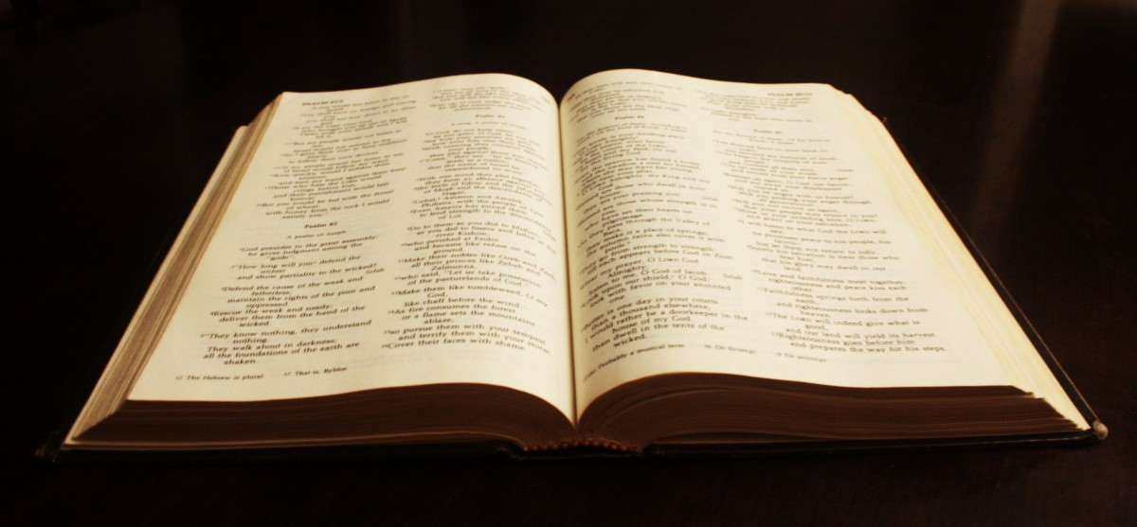
The Truth

Slide 4


Slide 5

The Life

