Slide 1
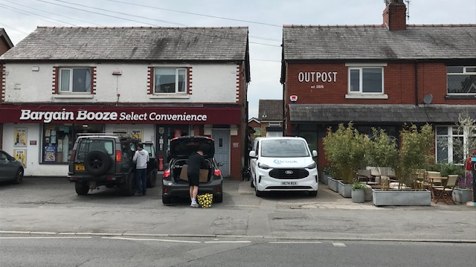

Slide 2
‘I am the Bread of Life’
Humanity

Slide 3
‘I am the Bread of Life’
Humanity
Hospitality

Slide 4


Slide 5
‘I am the Bread of Life’
Humanity
Hospitality
Heavenly Bread

Slide 6
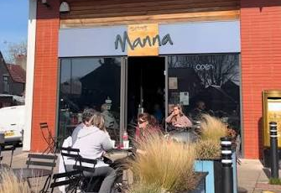

Slide 7
‘Jesus did many other signs in the presence of his disciples which aren’t written in this book, but these are written so that you may believe that the Messiah, the Son of God, is none other than Jesus, and that with this faith you may have life in his name.’
John 20:31

Slide 8


